Slide 1
Exploratory Data Analysis on Big Mart Product Sale
By:-
E-ADA-098 Chinmaya Pradhan
E-ADA-141 Radhashree Bose
E-ADA-167 Vishal Budhadev

Slide 2
About Big Mart Dataset
Big Mart is a grocery store chain that stocks grocery items such as fruits and vegetables, health and hygiene products, bakery items, and many more such daily products.
This dataset consists of sale insights for various Big Mart products that were sold at various Big Mart Outlets at various locations.
Through this Exploratory Data Analysis Project, we are trying to gain a better insight into the sales trends at Big Mart and various factors related to it. We will also attempt in providing helpful insights that can be commercially beneficial to the business.

Slide 3
Downloading Dataset & Preparing Work-Environment
Preparing Work-Environment by downloading and importing all the relevant libraries which will be required by us to gain proper inference and insights.
Fetching the raw dataset as a pandas data frame to work with.

Slide 4
Data cleaning and preparation
Two rows, namely Item_Weight and Outlet_Size have null values.
Handled null values in the Item_Weight column using the mean value of the column.
Handled null values in the Outlet_Size column using the KNN-Imputer method.
Handled ambiguous values of the Item_Fat_Content column.
Our data frame is now clean and ready to work with.

Slide 5
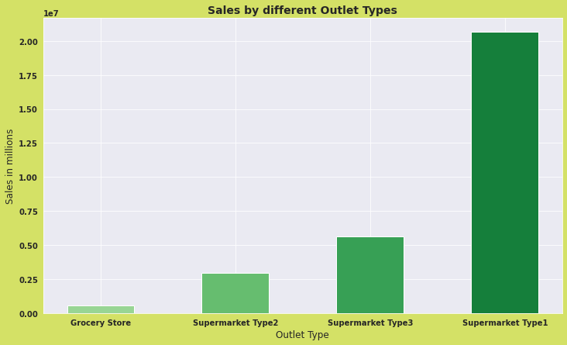
Outlet Type wise Sale of Big Mart
We have calculated the total sale made by Big Mart and then compared the Outlet Sales based on the Outlet Type.
We can easily visualize that the Type 1 Supermarket has the best sales.

Slide 6
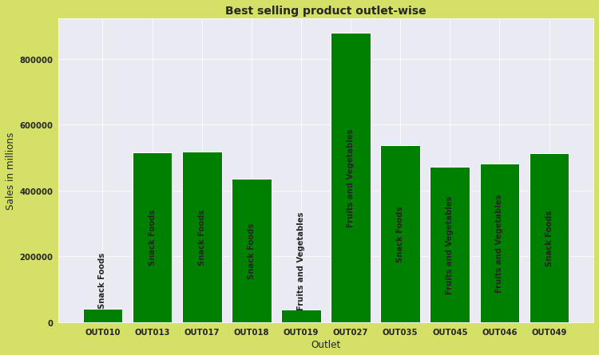
Max Sale of Each Item in Each Outlet
Big Mart has many outlets and each outlet sells numerous items. Here we have analyzed which item is sold the maximum and in which outlet.
The adjacent graph shows us which item has the maximum sale in respective which outlet.
This inference helps us understand which item is in more demand or should be stocked more in a specific outlet.

Slide 7
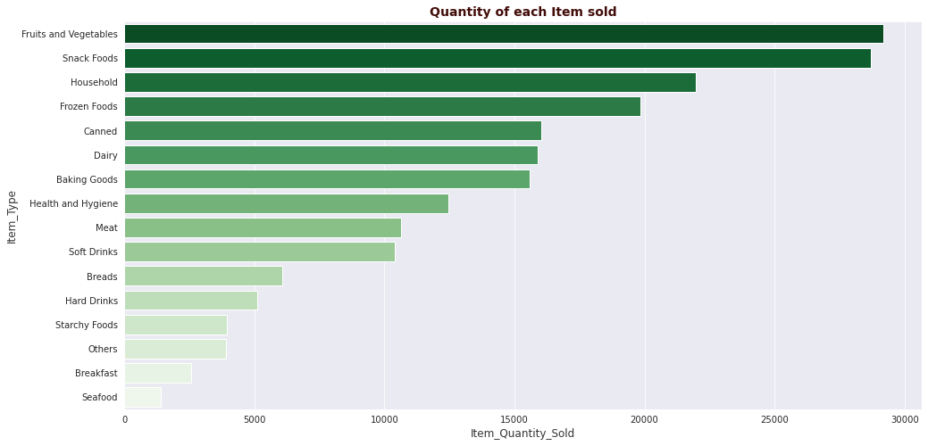
Quantity of Each Item Sold
The above plot gives an idea of which item is consumed the most across all the outlets of Big Mart.
Thus Fruits and Vegetables can be referred to as the hero products of Big Mart.

Slide 8
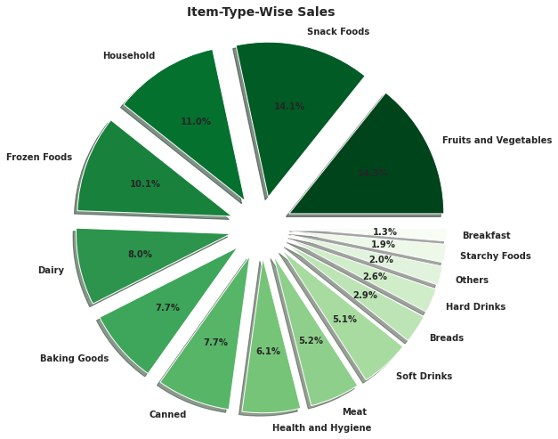
Item Type Wise Sales
Sale of each type of item available in Big Mart.
The adjacent graph shows the percentage-wise sale of each item across all the outlets.

Slide 9
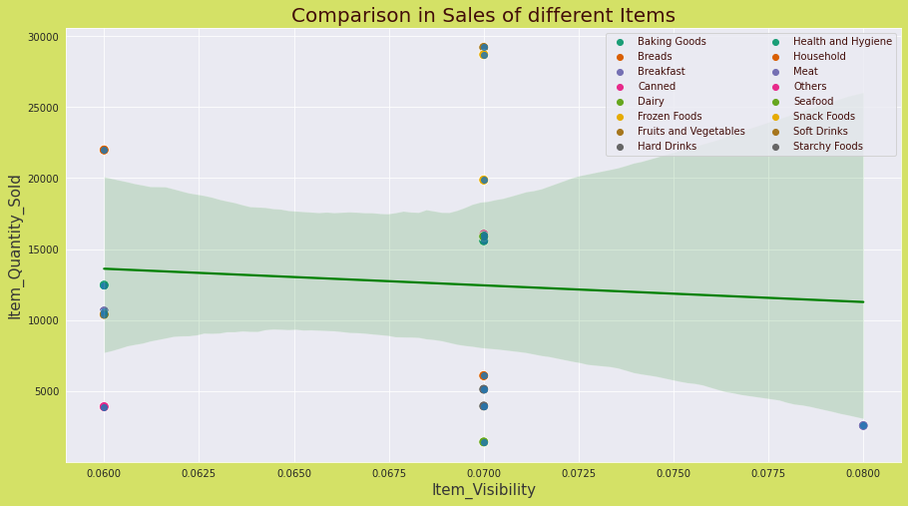
Sale of Products based on their Visibility
We have plotted a graph to show the relation between the quantity of items sold based on their average visibility in all the stores.
The regression line and results of correlation function depict that there is almost no relation or inverse relation between visibility and quantity sold.

Slide 10
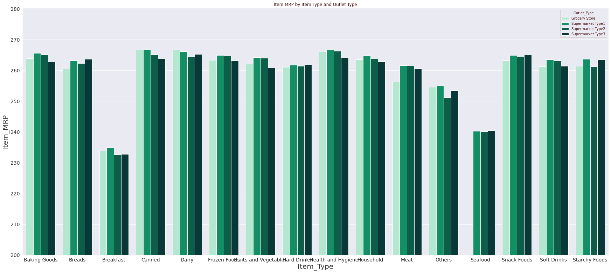
Plot to show
MRP vs Outlet Type

Slide 11
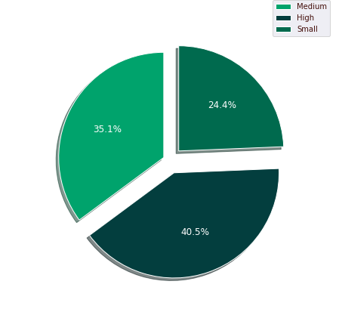
Sale vs Outlet Size
This graph depicts how sales are affected based on the outlet size.
Henceforth we conclude that the sale decreases with a decrease in the store size and vice-versa.

Slide 12
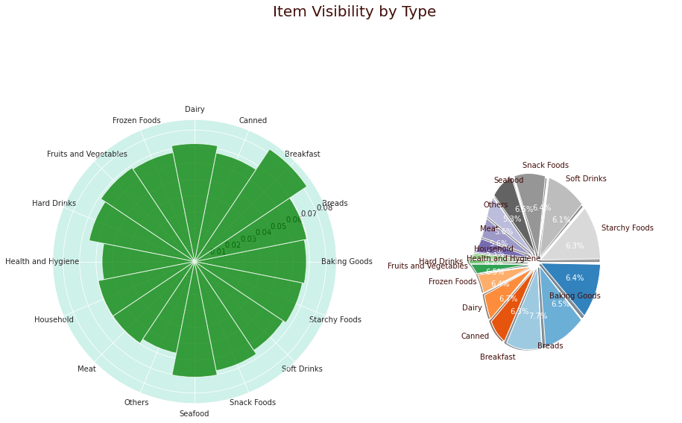
Average Visibility of each item
Plots to show

Slide 13
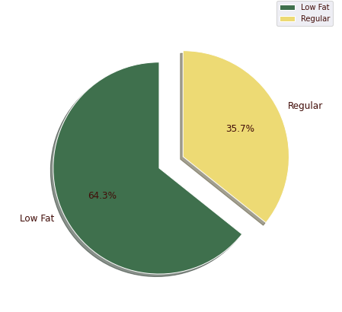
Effect Of Fat Content on the Sale of Items
The pie chart depicts the sales of items based on their fat content.
Hence it can be clearly concluded that lower the fat content in an item, the higher its demand and hence higher the sale.

Slide 14
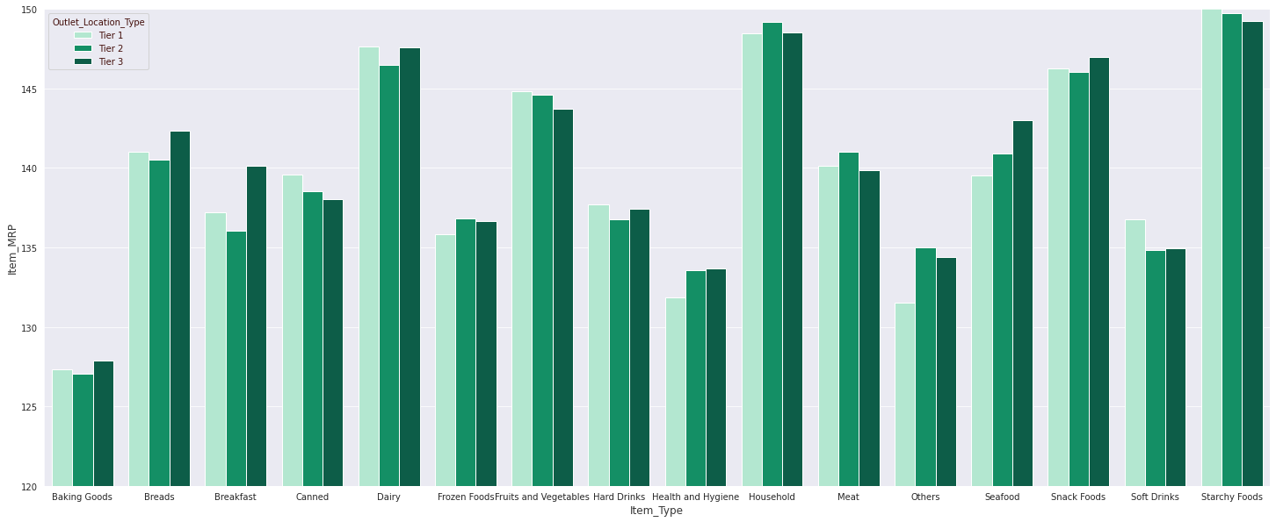
Mrp based on Outlet location type
The above graph is plotted to show how the MRP of each item varies based on Outlet Location.

Slide 15
Inferences & Conclusion
From the above graphs and inferences made with reference to the dataset, we draw the following conclusions from the questions asked about the data:
Total revenue of the Big Mart grocery chain is approximately 30 million dollars.
Big Mart caters to 16 different categories of products.
Older establishment doesn't guarantee better sales.
Type 1 Supermarkets have the best sales.
What product is in higher demand and hence should be stocked more in which outlet?
Fruits and Vegetables are the hero product of the Big Mart grocery chain.
More visibility doesn't guarantee better sales.
There is low to no variance in the price of products based on Outlet type.
Breakfast items have the overall highest average visibility.
Low-fat items are in higher demand.
There is some variance in price based on outlet location.

Slide 16
Contributions
Data preparation and cleaning: Chinmaya Pradhan(E-ADA-098) and Radhashree Bose(EADA-141)
EDA: Chinmaya Pradhan(E-ADA-098) and Radhashree Bose(EADA-141)
Visualizations: Vishal Budhadev(E-ADA-167), Chinmaya Pradhan(E-ADA-098) , and Radhashree Bose(EADA-141)
PPT: Vishal Budhadev(E-ADA-167)

